Slide 1
Swift language
Nested Loops

Slide 2
OBJECTIVE
NESTED LOOPS
NESTED FOR LOOPS
NESTED WHILE LOOPS
NESTED FOR – WHILE LOOPS

Slide 3
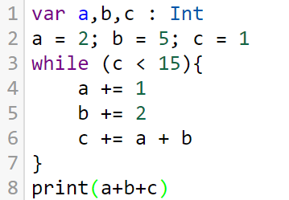
While loop
While (condition is true){
Statement 1
Statement 2
Statement n
}

Slide 4
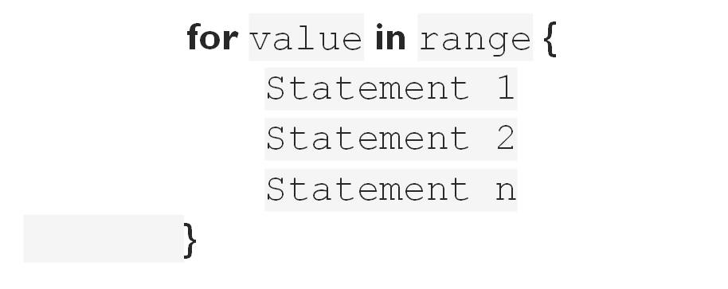
For loop

Slide 5
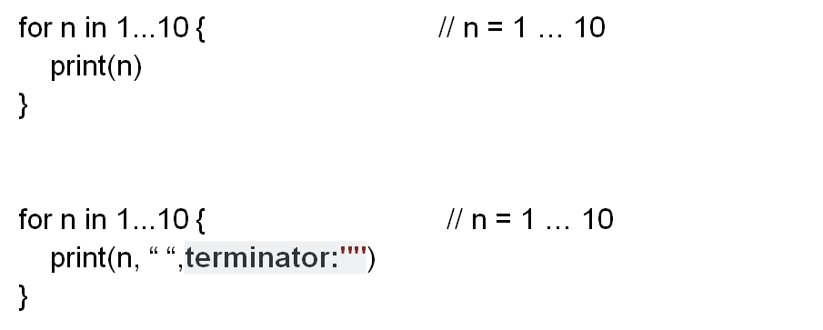
For loop

Slide 6
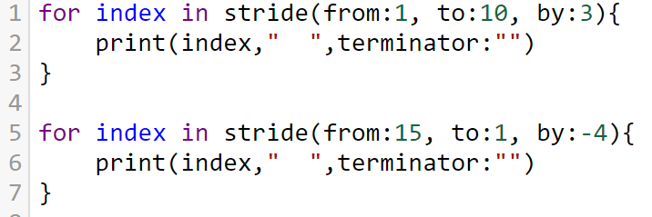
For loop

Slide 7
NESTED LOOPS?
ST 1
ST 2
ST N

Slide 8
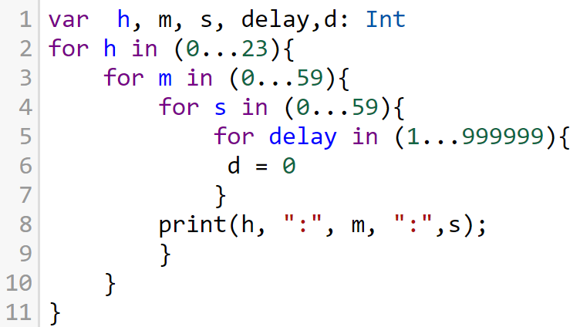

Slide 9
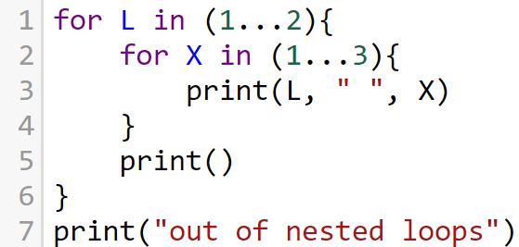

for L in (1...2){
for X in (1...3){
print(L, " ", X)
}
print()
}
print("out of nested loops")

Slide 10
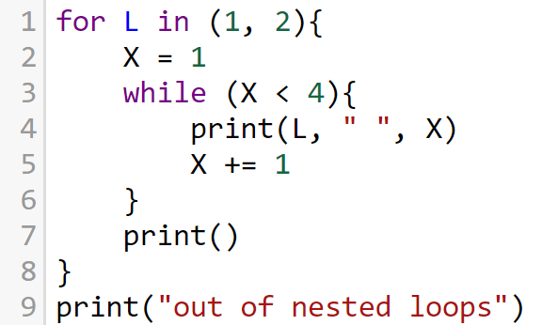
for L in (1, 2){
X = 1
while (X < 4){
print(L, " ", X)
X += 1
}
print()
}
print("out of nested loops")

Slide 11
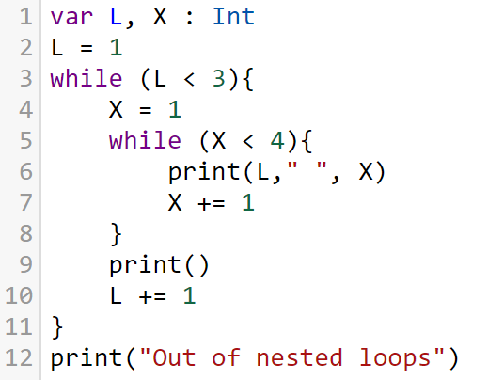
var L, X : Int
L = 1
while (L < 3){
X = 1
while (X < 4){
print(L," ", X)
X += 1
}
print()
L += 1
}
print("Out of nested loops")

Slide 12
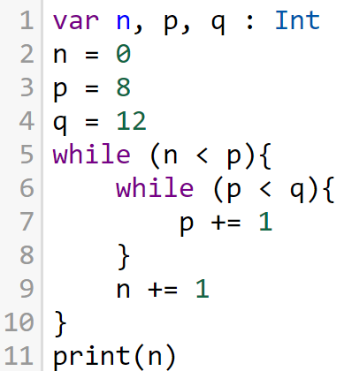
var n, p, q : Int
n = 0
p = 8
q = 12
while (n < p){
while (p < q){
p += 1
}
n += 1
}
print(n)

Slide 13
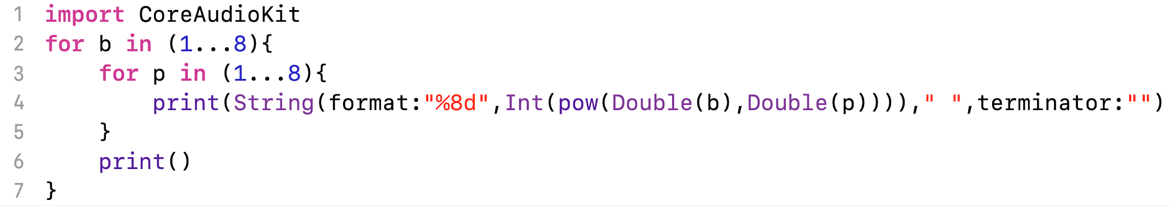
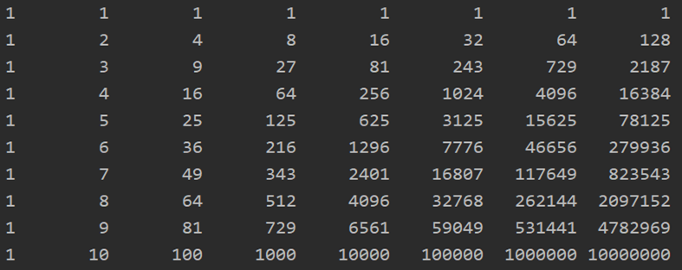
import CoreAudioKit
for b in (1...8){
for p in (1...8){
print(String(format:"%8d",Int(pow(Double(b),Double(p))))," ",terminator:"")
}
print()
}

Slide 14
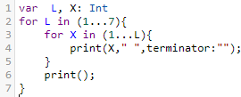
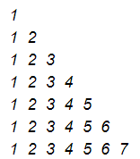
var L, X: Int
for L in (1...7){
for X in (1...L){
print(X," ",terminator:"");
}
print();
}

Slide 15
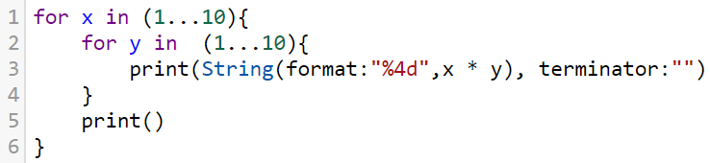
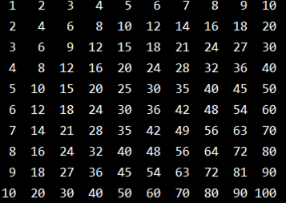
for x in (1...10){
for y in (1...10){
print(String(format:"%4d",x * y), terminator:"")
}
print()
}

Slide 16
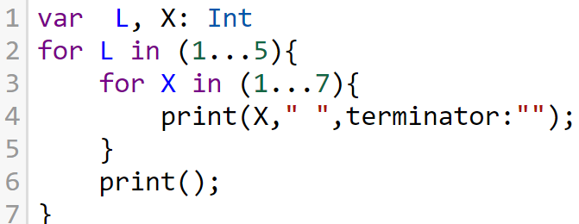
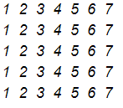
var L, X: Int
for L in (1...5){
for X in (1...7){
print(X," ",terminator:"");
}
print();
}

Slide 17
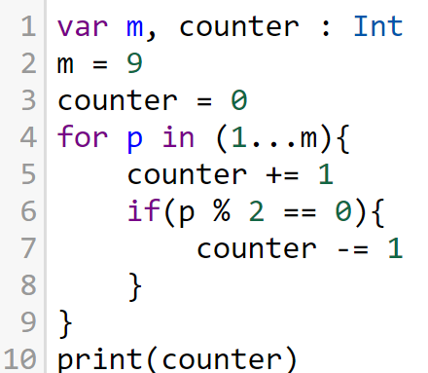
var m, counter : Int
m = 9
counter = 0
for p in (1...m){
counter += 1
if(p % 2 == 0){
counter -= 1
}
}
print(counter)

Slide 18
var stars, spaces: Int
stars = 1
spaces = 4
for _ in (1...4){ //Line loop
for _ in (1...spaces){ // space loop
print(" ", terminator:"")
}
for _ in (1 ... stars){ //star loop
print("*",terminator:"")
}
print()
stars += 2; spaces -= 1
}
stars = 5; spaces = 2
for _ in (1...3){ //Line loop
for _ in (1...spaces){ // space loop
print(" ", terminator:"")
}
for _ in (1 ... stars){ //star loop
print("*",terminator:"")
}
print()
stars -= 2
spaces += 1
}
*
***
*****
****** *
*****
***
*

Slide 19
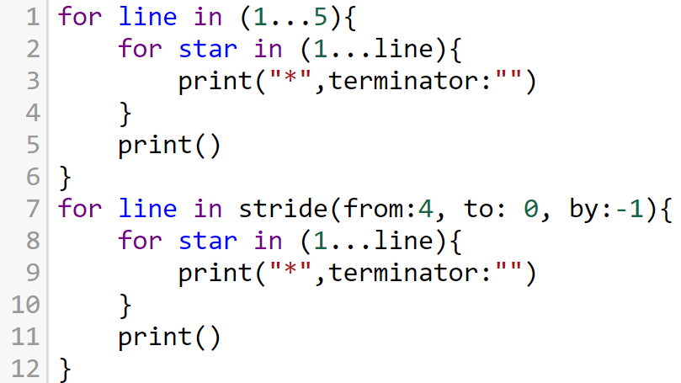

for line in (1...5){
for star in (1...line){
print("*",terminator:"")
}
print()
}
for line in stride(from:4, to: 0, by:-1){
for star in (1...line){
print("*",terminator:"")
}
print()
}

Slide 20
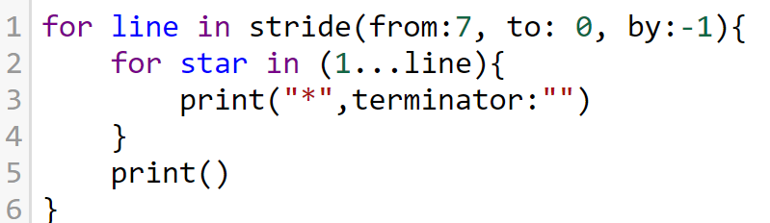

for line in stride(from:7, to: 0, by:-1){
for star in (1...line){
print("*",terminator:"")
}
print()
}

Slide 21
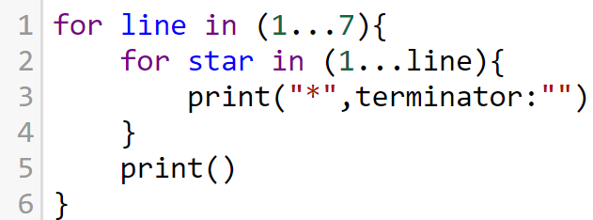

for line in (1...7){
for star in (1...line){
print("*",terminator:"")
}
print()
}

